Slide 1

Έργο CYberSafety Ένα καλύτερο διαδίκτυο για τα παιδιά στην Κύπρο (Safer Internet Programme – Better Internet for Kids)
Συνάντηση εταίρων του έργου
Τετάρτη, 9 Οκτωβρίου 2019
Λευκωσία
Ζέτα Καπιτσάκη, Πασχάλης Μπέης
Πανεπιστήμιο Κύπρου
Agreement number: INEA/CEF/ICT/A2018/1614254 Action No: 2018-CY-IA-0012

Slide 2

Researcher’s Night (Activity 1: Awareness Raising)
Sept. 27th (and Sept. 26th)
Participated together with CUT
Activities:
Presented eFollowMe web game, and gave leaflets of the game
Explained importance of CYberSafety II project
Talked to children and parents about helpline/hotline
Listened to suggestions and worries from parents
What their children do online
Are the apps they use safe
Control their web and app usage on tablets

Slide 3
T4.1 Development of a Privacy awareness tool
PrivacySaferII browser extension
New version of our former PrivacySafer
web browsers: Android Chrome, Mozilla Firefox
English and Greek

Slide 4
PrivacySaferII
Deliverables
D.4.1.1. Main GDPR guidelines for students and parents
D.4.1.2. Requirements of browser extension
D.4.1.3. Design of browser extension
D.4.1.4. Implementation of browser extension – 1st version expected 11/2019
D.4.1.5. Browser extension user guidelines

Slide 5
PrivacySaferII
Implementation of front end
Use of React JavaScript framework
Initially, no user data will be stored

Slide 6
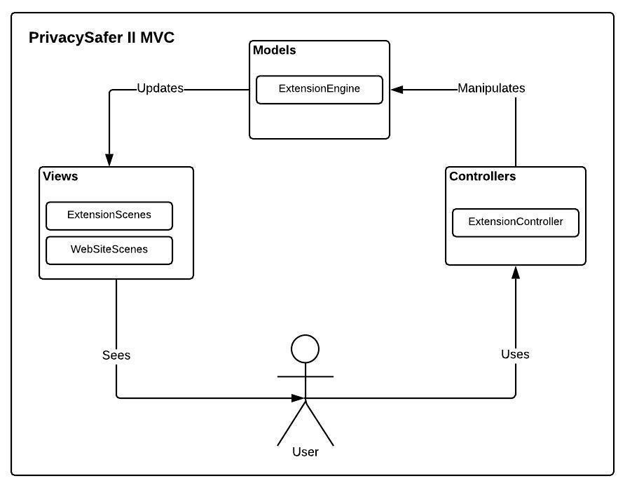
PrivacySaferII

Slide 7
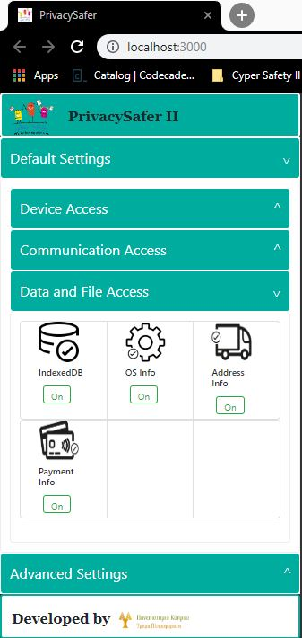
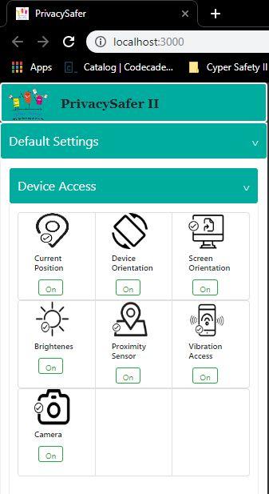
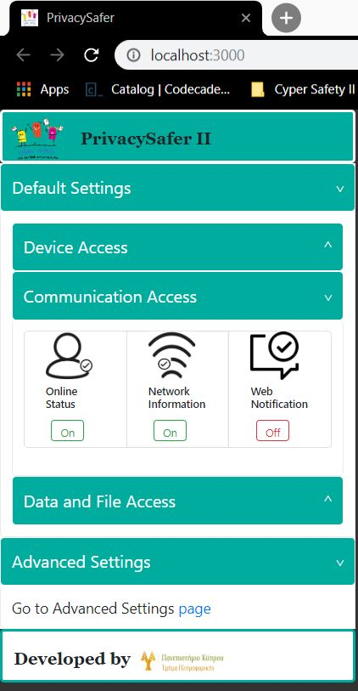

Slide 8
T4.2 Development of an application analysis toolset
Web-based toolset that analyses mobile/web applications and reports sensitive data they request from users
Allows users to upload a mobile application (in the form of .apk file for Android) or reference the URL of a website
Provide feedback to the users on the kind of personal data the respective application or website requires
Notes:
2 versions: one for students (aged 12-17),one for parents (i.e., adults)
Collaboration with Activity 1 - The procedure for uninstalling and subsequently requesting the deletion of sensitive or private information will be established under the Awareness activity and will reference compliance with the GDPR

Slide 9
T4.2 Development of an application analysis toolset
Deliverables
D.4.2.1. Tool requirements analysis
D.4.2.2. Tool design
D.4.2.3. Tool implementation and testing (2 variants of the tool, for students and parents) – 1st version expected 11/2019
D.4.2.4. Tool user guidelines

Slide 10
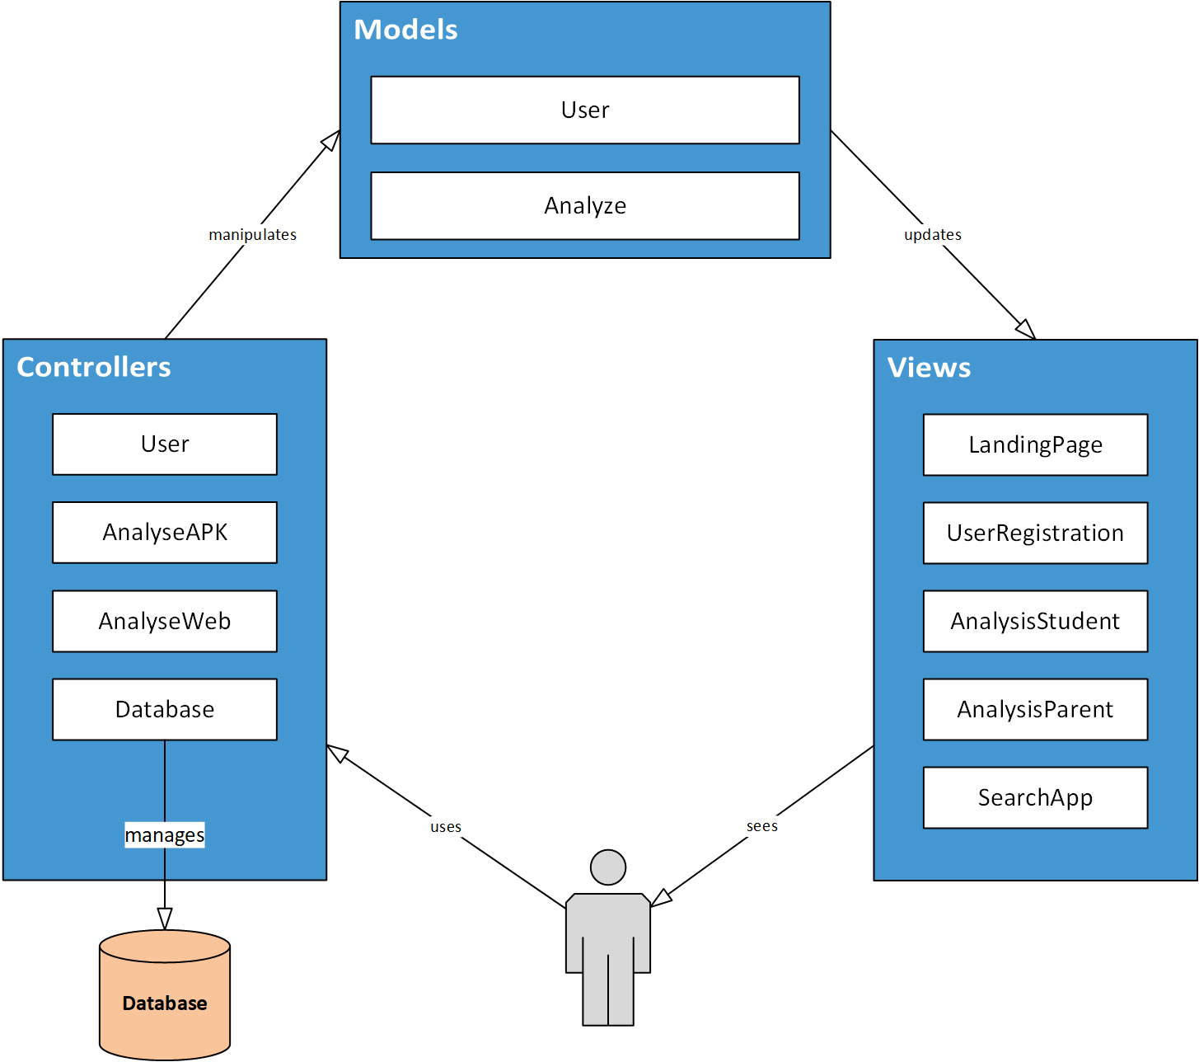
Awareness analysis tool (Activity 4)
Web application
Build with MVC model
Views:
Landing Page: prompt users to register
User Registration
Registered Users:
Search for analyzed apps
View analysis results depending on user type (child/parent)
Analyse a new application

Slide 11

Software stack: Frontend
Frontend:
vue.js:
JavaScript framework
Open Source
Modern, Popular
Plays well with our backend
Builds user interface
Single-page applications

Slide 12


Software stack: Backend
Backend:
Laravel:
PHP framework
Open Source
Modern, Popular
Fast, lightweight!
MVC architecture
Modular
Deployed:
Apache Web Server
MariaDB:
Relational Database

Slide 13
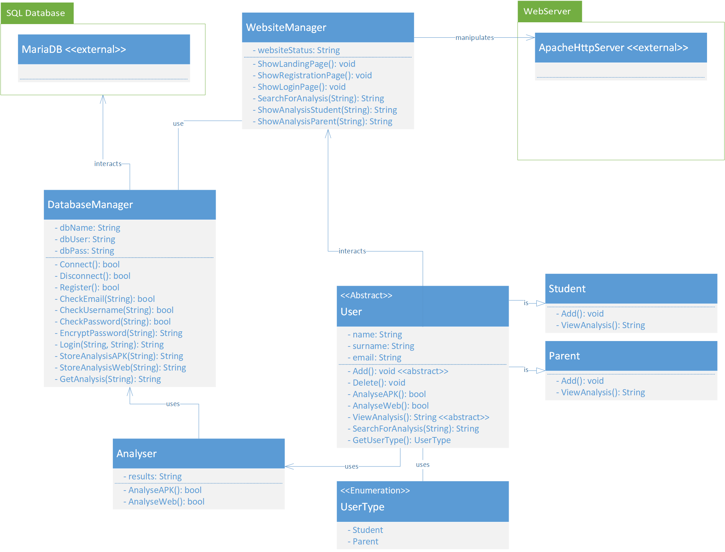
Architecture
Views
DB
Server
DB:
DatabaseManager:
Connections to database
Apache HTTP Server:
Serve the Views
User model:
Student or Parent
Interact with database
Content of the Views
External Tools:
Developed as standalone tools
Called by Laravel
Analyse APKs and Websites
DB
Model
ExternalTools

Slide 14
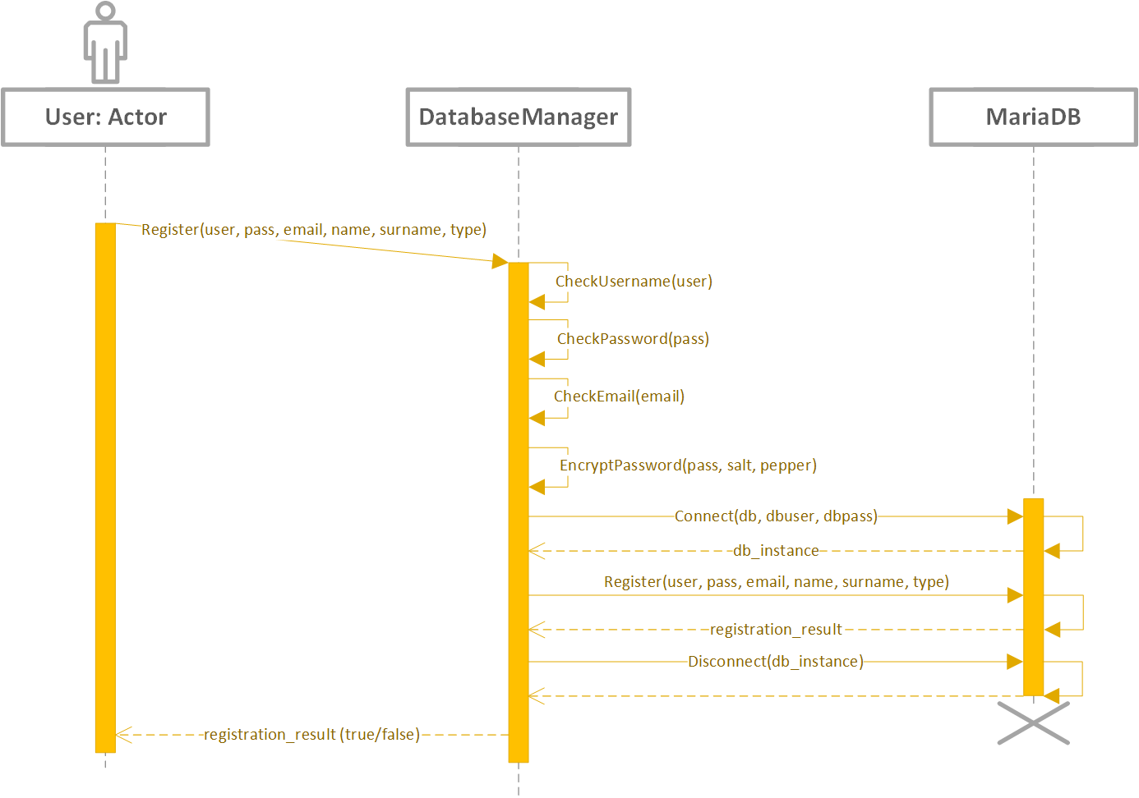
Registration Process (example)
Accept user data
In “register” view
Form validation:
Frontend:
HTML5 constraints, e.g. email
Vue.js: interactive & user friendly
Backend:
Laravel custom validators
Database:
Reject changes
Show error
(should never reach here!)
Store to database

Slide 15
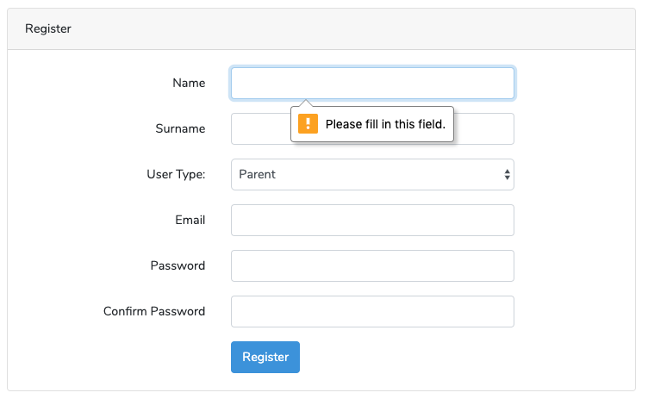
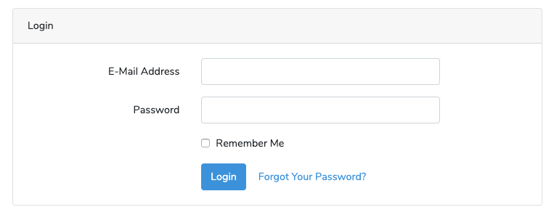
Registration Process (example)
Accept user data
Store to database
Login:
Access website services

Slide 16
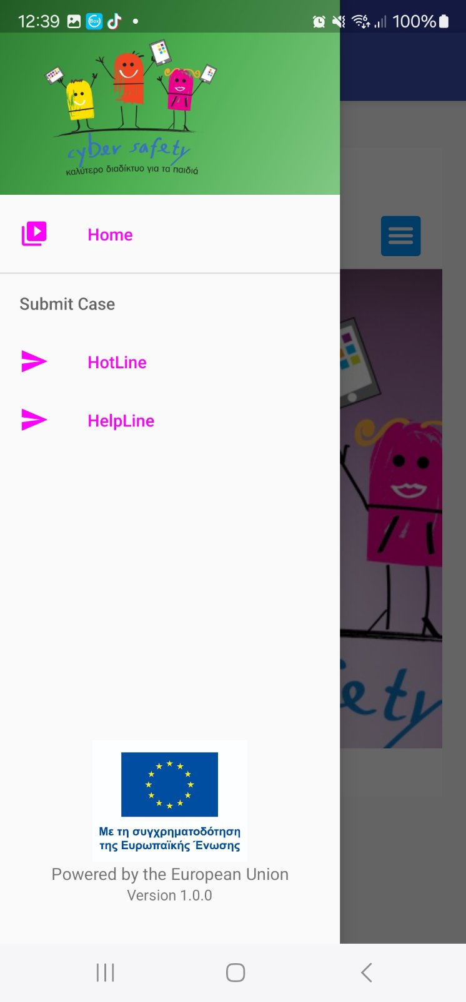
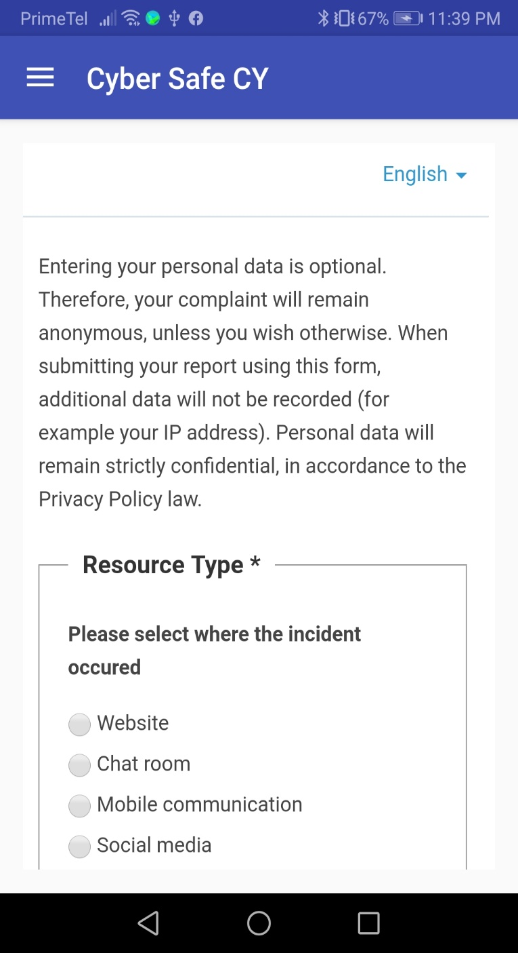
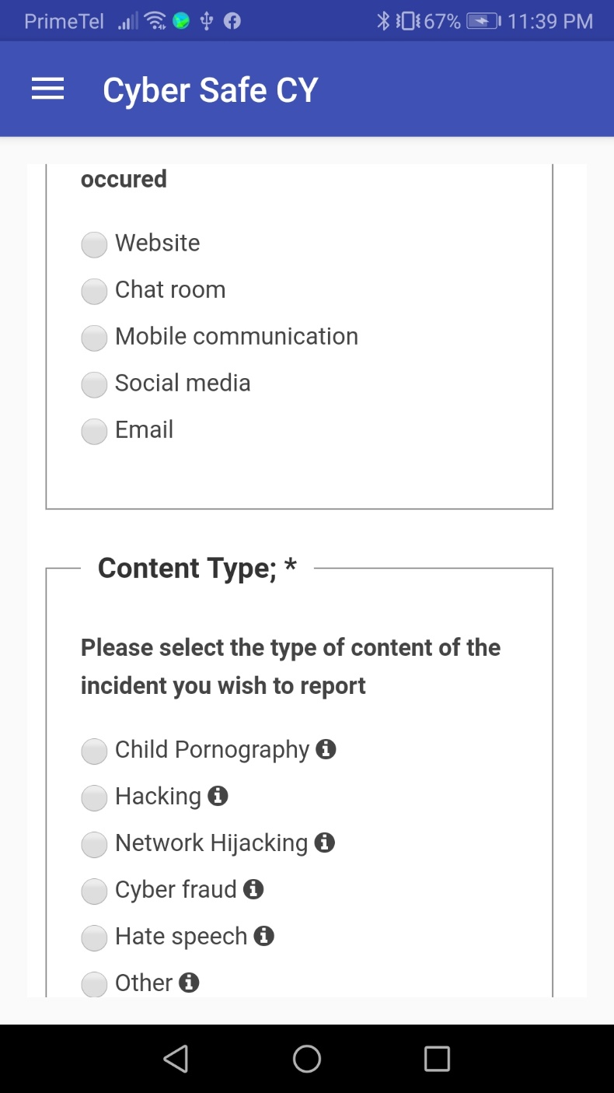
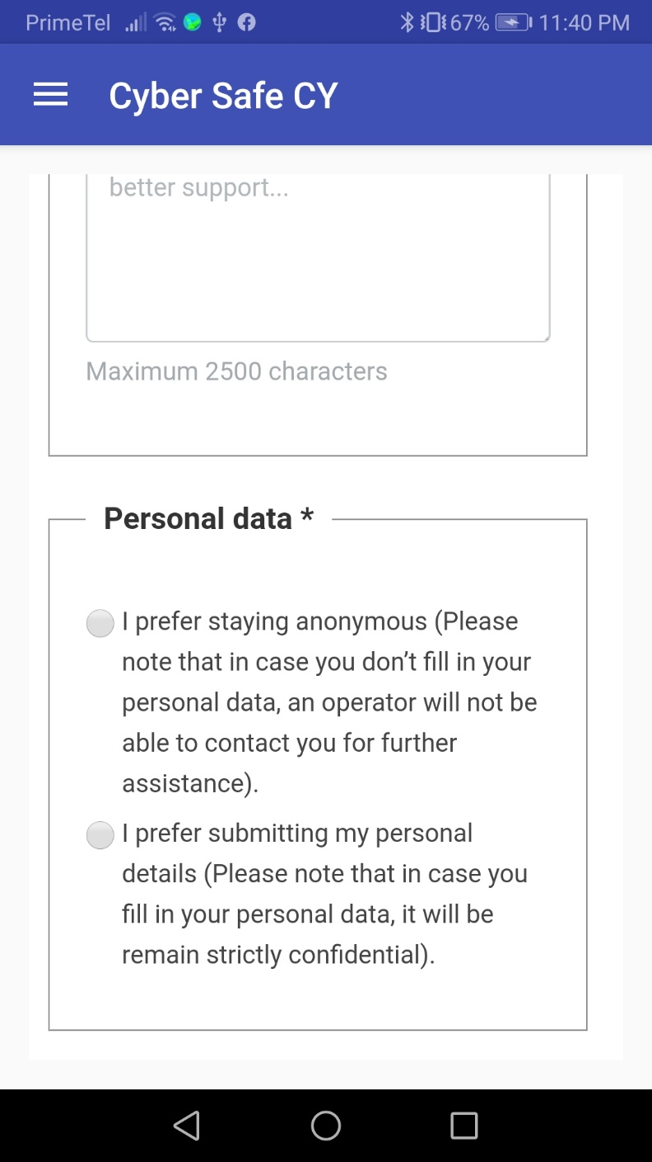
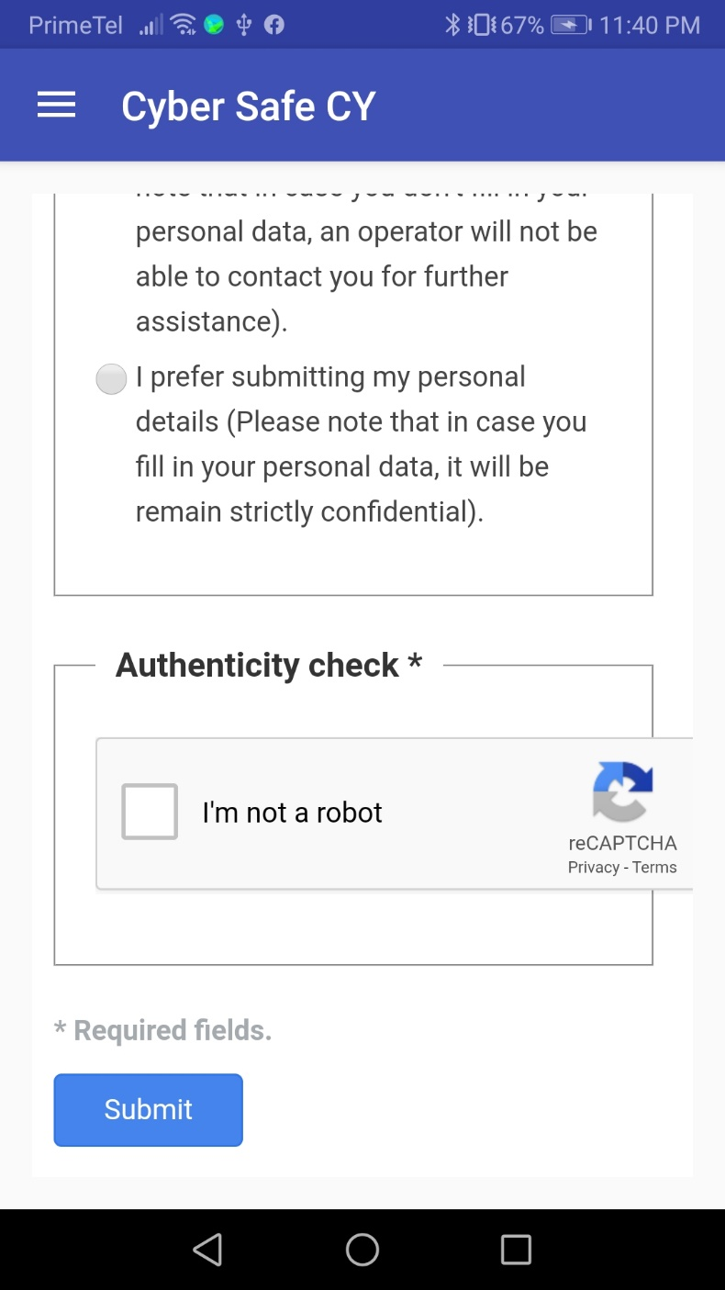
CyberSafe Android Application
Cyber Safety in Children Hands!

Slide 17
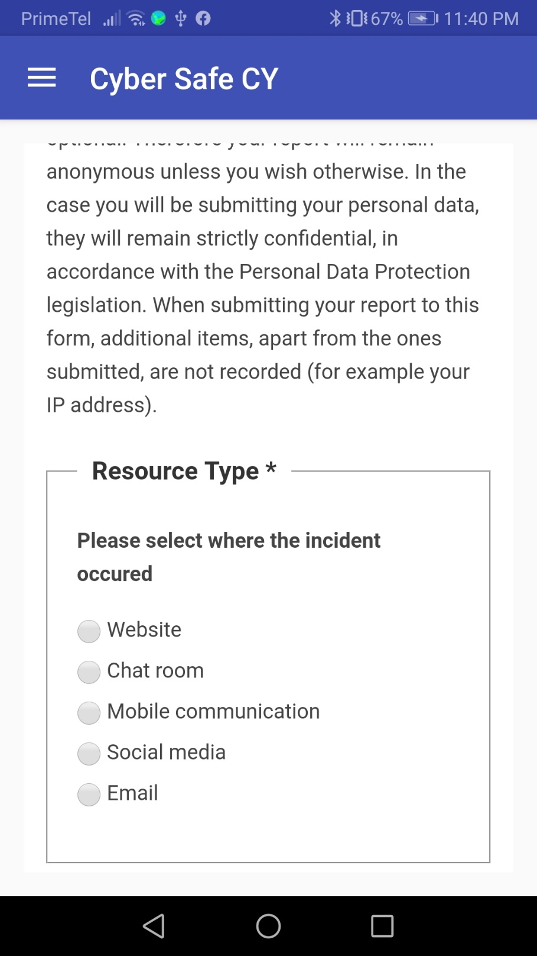
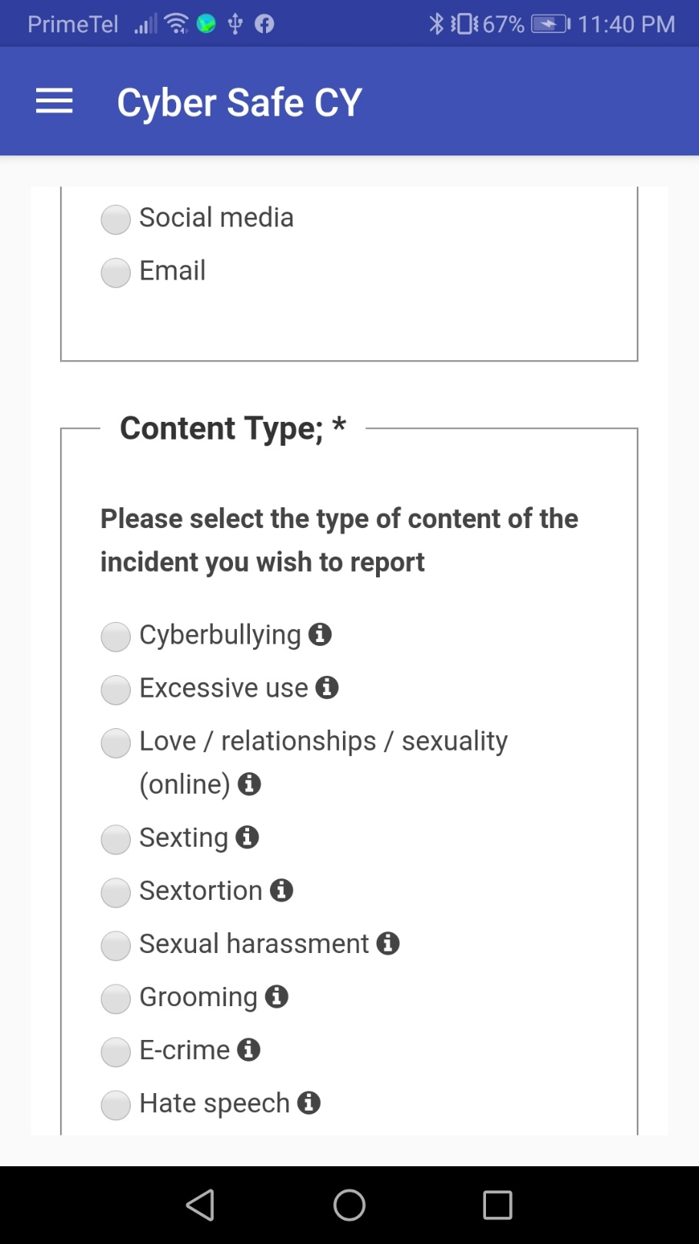
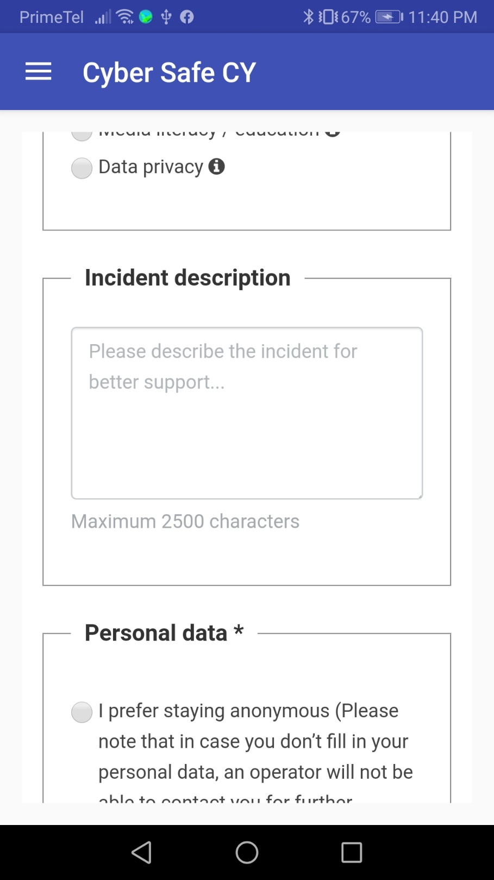
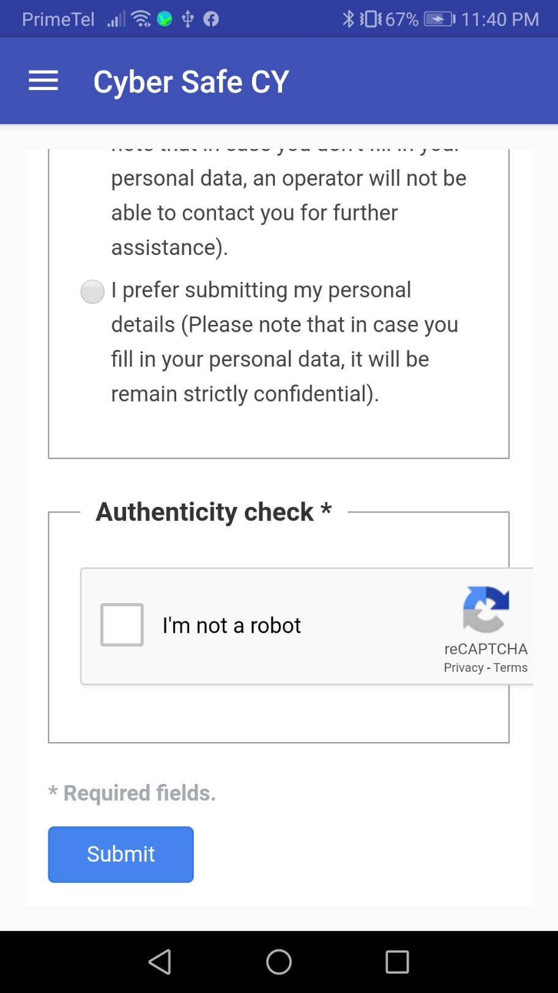
CyberSafe Android Application

